Slide 1
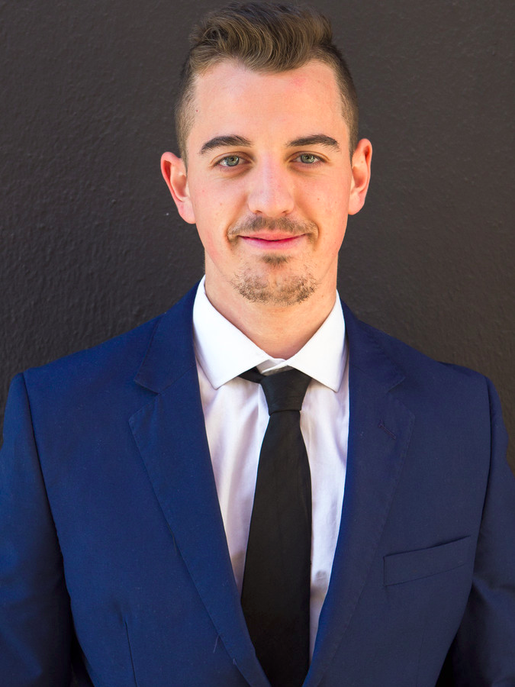

About myself
Name: Julian Hatzky
Career:
Studying at TH Köln since 2015
Working as a Data Scientist at inovex GmbH
Founder of Cologne School of AI
Related Projects:
Designing and implementation of a processor for an FPGA in VHDL (Rechnerarchitektur)
GatesDect: A Natural Language Processing Neural Network that can determine whether an article was written by Bill Gates
Reinforcement Learning for Recommendation Systems

Slide 2
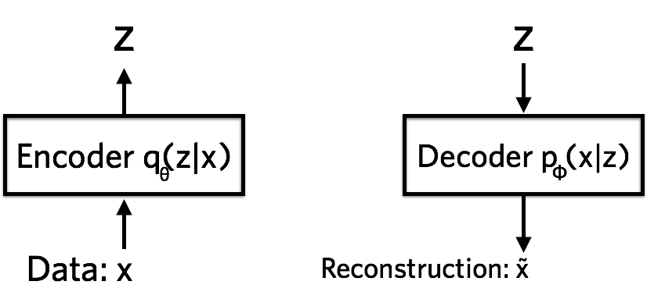
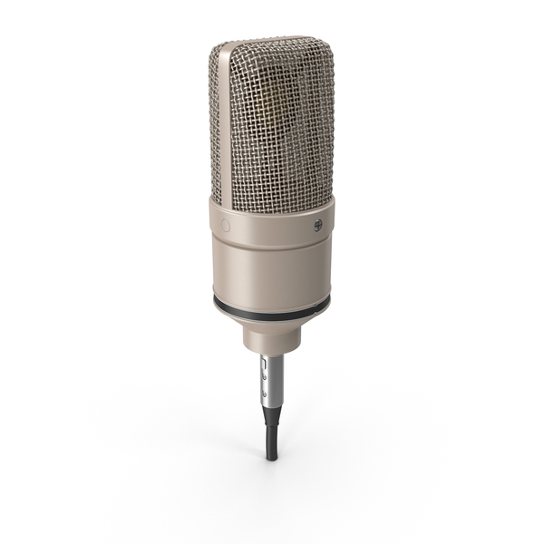
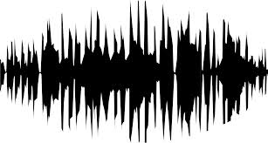
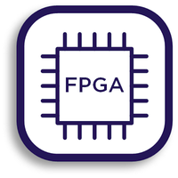

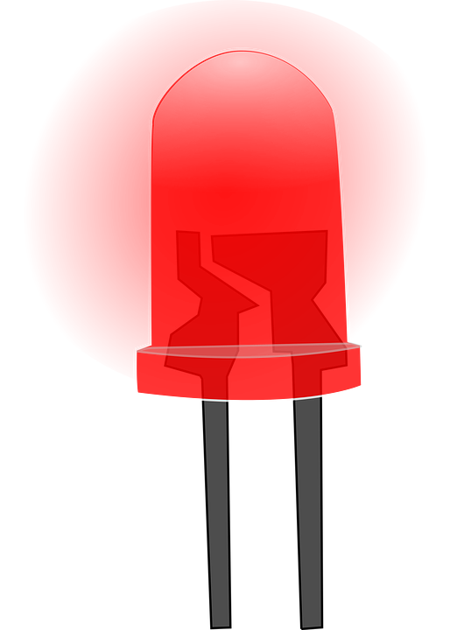
About the project
Is this the learned Audio Signal ?
Use a Neural Network implemented on a FPGA to detect a specific Audio Signal.

Slide 3
What are the main problems and possible solutions?
Only a few Audio Samples
Data augmentation
Choosing of a Framework
Evaluation of Pytorch and Keras/Tensorflow as possible candidates
Using the appropriate Neural Network/ Machine Learning Algorithm
Try different algorithms on the Data and see what fits the best (computer)
Storing/Using the Audio Data on the FPGA
USB interface and FIFO buffer
Describing a Neural Network in VHDL
Implementing a small architecture with only a few Neurons for a proof of concept

Slide 4

Project timeline
MS1
Augmented Audio Samples
MS3
Trained Neural Network
MS5
Neural Network PoC on FPGA
MS5.5
Complete Neural Network implementation on FPGA
26.04.2019
17.05.2019
19.04.2019
10.05.2019
31.05.2019
Testing and specification
MS2
Evaluation of Frameworks
MS4
Usage of Audio Data on FPGA
MS6
Zwischenbericht:
14.06.2019
Fertiggestellte Teilaufgaben
MS7
Abschlusspräsentation:
12.07.2019
Vollständiger Bericht
Kick-off:
12.04.2019
Projektvorstellung

Slide 5
Milestones
MS1
Augmented Audio Samples
Challenges:
Each Audio Sample should differ from the other (unique) but not too much. It still has to be the noise.
Creating accurate algorithms can be challenging
MS2
Evaluation of Frameworks
Challenges:
The frameworks each have their unique functions and behaviours. That’s why it needs time to understand the framework and have the possibility to use it for creating Neural Networks
MS3
Trained Neural Network
Challenges:
Training a Neural Network is always tough. The features (audio samples) have to be prepared well and labeled in a good manner / data format.
Also interpreting and using the output is pretty hard

Slide 6
Milestones
MS1
Augmented Audio Samples
Output:
algorithms to perform (stretching, shifting,..) on audio data
a lot of different (but similar) samples
Jupyter Notebook with explanation
MS2
Evaluation of Frameworks
Output:
A document describing pros and cons of evaluated frameworks
Decision which framework to use
MS3
Trained Neural Network
Output:
Different Neural Networks trained with the Audio Samples
A comparison between Neural Networks
A test on how got the Audio Data is getting detected
Jupyter Notebook with explanation

Slide 7
Milestones
MS4
Usage of Audio Data on FPGA
Challenges:
Understand how to transfer and use the audio samples on the FPGA.
Store them in a correct manner
A lot of documentary and introductions have to be read in order to understand how and in which way to do it
MS5
Neural Network PoC on FPGA
Challenges:
There are just a few papers yet, covering possibilities on how to do it. (find an “easy” implementation)
The challenge is to measure and design a Neural Network, test it and hopefully get some desired feedback
This is probably the most difficult milestone
MS5.5
Complete Neural Network implementation on FPGA
Challenges:
If there is enough time an overall goal would be to run the audio sample algorithm on the FPGA

Slide 8
Milestones
MS4
Usage of Audio Data on FPGA
Output:
It is possible to transfer and use Audio Data on the FPGA
MS5
Neural Network PoC on FPGA
Output:
It is possible to run and use a neural network on the FPGA which gets input data and processes the right output
MS5.5
Complete Neural Network implementation on FPGA
Output:
The neural network can detect if it’s the sampled audio data and if so it will turn on a LED.

Slide 9
Specifications
Audio Sample Analysis: TBA (Matplotlib / Matlab)
Hardware Description Language: VHDL
Design Software: Altera Quartus 2
Programming Language: Python
Python Framework: TBA (Keras/Tensorflow , Pytorch)
Computer: Hp Notebook, Google Collaboration (Cloud GPU, Jupyter Notebook)
Version Control: Git
FPGA: ALTERA DE2 Board

Slide 10

Questions?

